Slide 1
Object oriented programming (oop)
CORE CONCEPTS & EXAMPLES
PRESENTED BY : VRAJ SHAH

Slide 2
Index :
1. Introduction to Object Oriented Programming in Python.
2. What are Classes and Objects?
3. Object-Oriented Programming methodologies:
• Inheritance
• Polymorphism
• Encapsulation
• Abstraction

Slide 3
1. Introduction to Object Oriented Programming in Python :
Object Oriented Programming is a way of computer programming using the idea of “objects” to represents data and methods. It is also, an approach used for creating neat and reusable code instead of a redundant one.

Slide 4
2. What are Classes and Objects?
A class is a collection of objects or you can say it is a blueprint of objects defining the common attributes and behavior. Now the question arises, how do you do that? Class is defined under a “Class” Keyword.
Example:

Slide 5
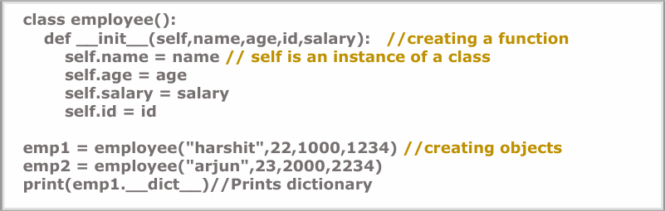
Creating an Object and Class in python:
Example:

Slide 6
3. Object-Oriented Programming methodologies:
❑ Inheritance
❑ Polymorphism
❑ Encapsulation
❑ Abstraction

Slide 7
Inheritance:
Ever heard of this dialogue from relatives “you look exactly like your father/mother” the reason behind this is called ‘inheritance’. From the Programming aspect, It generally means “inheriting or transfer of characteristics from parent to child class without any modification”. The new class is called the derived/child class and the one from which it is derived is called a parent/base class.

Slide 8
Types of inheritance :
❑ Single inheritance
❑ Multilevel inheritance
❑ Hierarchical inheritance
❑ Multiple inheritance

Slide 9
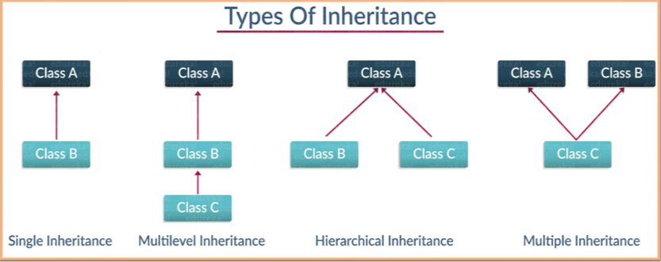

Slide 10
Single Inheritance:
Single level inheritance enables a derived class to inherit characteristics from a single parent class.

Slide 11
Multilevel Inheritance:
Multi-level inheritance enables a derived class to inherit properties from an immediate parent class which in turn inherits properties from his parent class.

Slide 12
Hierarchical Inheritance:
Hierarchical level inheritance enables more than one derived class to inherit properties from a parent class.

Slide 13
Multiple Inheritance:
Multiple level inheritance enables one derived class to inherit properties from more than one base class.

Slide 14
Polymorphism:
You all must have used GPS for navigating the route, Isn’t it amazing how many different routes you come across for the same destination depending on the traffic, from a programming point of view this is called ‘polymorphism’. It is one such OOP methodology where one task can be performed in several different ways. To put it in simple words, it is a property of an object which allows it to take multiple forms.

Slide 15
Polymorphism is of two types:
❑ Compile-time Polymorphism
❑ Run-time Polymorphism

Slide 16
Compile-time Polymorphism:
A compile-time polymorphism also called as static polymorphism which gets resolved during the compilation time of the program. One common example is “method overloading”

Slide 17
Run-time Polymorphism:
A run-time Polymorphism is also, called as dynamic polymorphism where it gets resolved into the run time. One common example of Run-time polymorphism is “method overriding”.

Slide 18
encapsulation:
Encapsulation is one of the core concepts of Object-Oriented Programming (OOP). It refers to the bundling of data (attributes) and methods (functions) that operate on that data into a single unit, i.e., a class. It also involves restricting direct access to some of the object’s components, which helps to protect the internal state of an object.

Slide 19
Abstraction:
Suppose you booked a movie ticket from bookmyshow using net banking or any other process. You don’t know the procedure of how the pin is generated or how the verification is done. This is called ‘abstraction’ from the programming aspect, it basically means you only show the implementation details of a particular process and hide the details from the user.

